Slide 1
Software Engineering
Lesson 4 – Single Release vs Multiple Release process Models

Slide 2
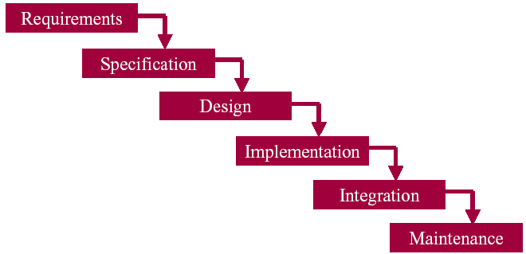
Last Time we covered…
Stages of the Software Process and tasks carried out on each stage
Planning and Feasibility study
Analysis
Design
Development (Coding)
Testing
Operation & Maintenance
Deliverables of each stage
Waterfall model as the 1st Process Model

Slide 3

Let’s summarize the material you’ve presented:
Common Process Models
Prince 2
Spiral Model
Incremental Model
Iterative Model
Evolutionary Model
Rapid Application Development

Slide 4

Incremental Model
Waterfall
Breaks down a project by activity (Planning stage, Analysis, Design, Coding, Testing, Maintenance)
Incremental
Breaks down a project by subsets of functionality
Each iteration will implement a part of full requirements
For each iteration you will go through a full life cycle
Result of any iteration should be of production quality and might be delivered to client
Following iterations might include rework and fixes
Automated Regression Tests
Refactoring
Continuous Integration
Hybrid (Staged)
Analysis and High level design done first
Coding and testing are divided into iterations
To get regular rhythm, use Time Boxing for iterations

Slide 5

Incremental Development
System is developed in increments (builds)
Define and Prioritize Requirements
First increment will include the functions with highest priority
Each increment is developed using the most appropriate approach
Each following increment adds new functions
Each build integrated with structure & product tested as a whole
Each increment is then delivered to client for evaluation and use
Client is not permitted to demand changes for the completed increments, only bug fixes
Requirements
phase
Verify
Specification
phase
Verify
Architectural
design
Verify
For each build:
Perform detailed
design,
implementation,
integration. Test.
Deliver to client.
Operations mode
Maintenance
Development
Retirement

Slide 6
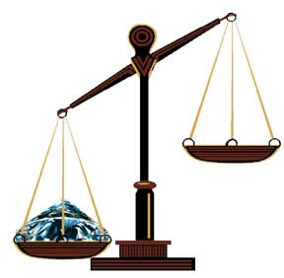
Incremental Model cont…
Advantages
Parts available for user evaluation at an early stage
Slow transition for user
Supports the requirements definition for the remainder of the project
Pay for product in installments
Reduces the risk of overall project failure, less bugs with the final system
Disadvantages
Difficult to integrate without regressing (faults)

Slide 7
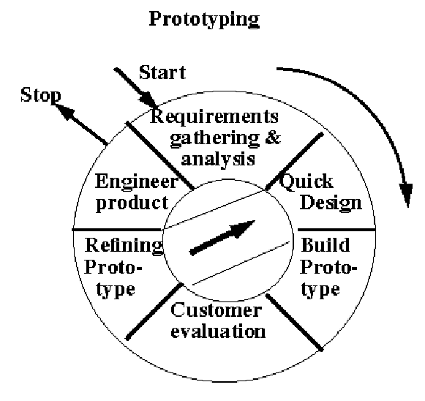

Iterative Model (Prototyping)
In an iterative life cycle model one does not gather full requirements, but specifies and implements just part of the software (prototype) , which can then be reviewed together with the client in order to identify further requirements.
Client reviews the product and makes suggestions for improvement
Prototype is altered accordingly
This process is then repeated, producing a new version of the software for each cycle of the model.

Slide 8
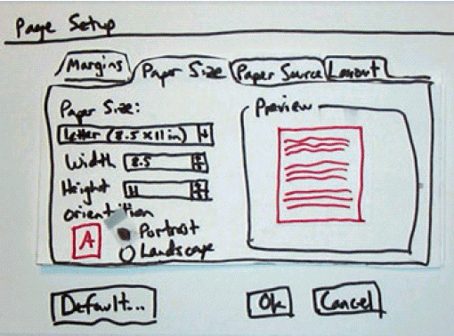
Prototyping Types
Prototypes - early versions of the software are for demonstration and requirements purposes
Evolutionary prototype – Working model, functionally equivalent to a subset of the product.
Throwaway prototype (rapid prototype)
usually only interface
Used for collecting requirements
Afterwards discarded and system is designed and developed with quality in mind

Slide 9
Assessment of Prototyping
Advantages
the prototype helps to detail user’s requirements;
users get the feeling about the future system
less chance of system rejected, since clients are involved in the development
Disadvantages
expectation management
delivering “everything” properly takes time
there is no clear indication when the prototyping should stop
turning prototypes into production code
Not always well documented...
Tends not to be “well designed”

Slide 10

Spiral Model
Combines iterative nature of prototyping and linear approach of classical model
Always some risk involved in software development
people leave… other products not delivered on time…
In prototyping getting the right requirements is the major risk
In waterfall model the schedule is seen as risk
Key idea - minimize risk
e.g., building prototypes & simulations minimizes risks
Precede each phase by
looking at alternatives
risk analysis
Quit if the risks can’t be quantified
Follow each phase by
evaluation
planning of next phase

Slide 11
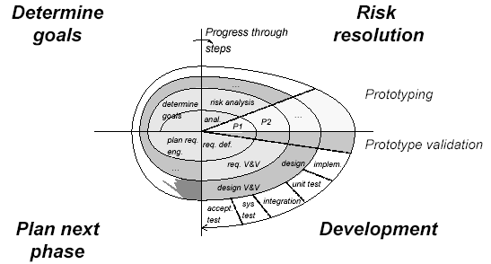
Spiral Model

Slide 12
Spiral Model steps within an iteration
The objectives of the commencing phase (loop) are set out, a management plan is created and possible project risks are identified.
The identified risks are analysed, and action is taken to reduce these risks.
Depending on the main risks that have been identified, a suitable development approach is taken.
The project is reviewed in order to decide whether the next development loop should be entered or whether the project should be abandoned.

Slide 13
Assessment of the Spiral Model
Advantages
Considers entire software life cycle
Adaptable
Disadvantages
Only suitable for large scale project (cost of risk analysis is high)

Slide 14

Rapid Application Development
RAD is an example of an incremental software development process
Software Development is done employing tools
Databases
User Interface Design Software
CASE tools
Used when the overall requirements are well known (but the detailed requirements are poorly specified) and where the project’s scope/time is constrained
Development is done in a series of time boxes

Slide 15

RAD: Time boxing
Users requirements should not be accepted blindly but should be debated and rated as(MoSCoW):
Must have
Should have
Could have
Won’t have
Developers keep to agreed delivery date at all costs, even if this means dropping some of the functional requirements (coulds and woulds) that were agreed for this iteration.
It’s better to slip a function than a deadline
A time box might be mapped:
To a phase (if all the functional model iteration is done before all the design and build iteration), or
To the development of a functional area (where the functional model iteration and the design and build iteration are done in alternation).

Slide 16

RAD: Assumptions
Design and testing is iterative
Application software is kept in a working state at all times
Users form an integral part of the development team. This may be difficult/expensive to organise

Slide 17
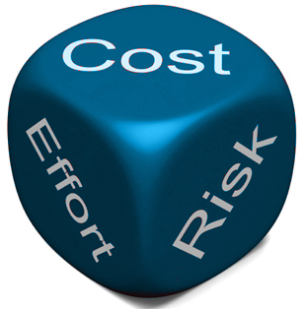
RAD: Cost of Application
Cost of application is determined not only by cost of development but the cost of maintenance as well
RAD offers cheaper development costs
But because the design is sometimes sacrificed for the sake of speed it might require a lot of maintenance, raising the total cost of application

Slide 18
Assessment of the RAD
Advantages
The application acts as its own model through the code as well as comments, i.e. it avoids the creation of lots of diagrams and documents)
It can produce working systems quickly
A small development team (4 -10 members) can develop a working system in a period of about 60 to 90 days.
Disadvantages
It is impossible to specify complex requirements in advance
It can result in error-prone and difficult to maintain systems

Slide 19

The PRINCE 2 Methodology
PRINCE 2 is an acronym for PRojects IN Controlled Environments.
The Malta Information Technology Association (MITA) also applies PRINCE 2 for all of its projects; many of which are systems destined for the public sector.
It is widely recognized and used in the private sector, both in the UK and internationally.

Slide 20
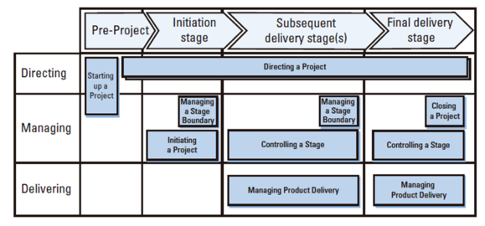
The PRINCE 2 Methodology
The structure of the PRINCE 2 Model :
Notes:
PRINCE 2 describes seven themes for a successful project:
Business Case
The reason for the project
Organisation
Defining the roles and responsibilities of the people involved i.e. the structure of the project team is defined.
Plans
Defining the project’s productsto achieve the desired outcome. This includes how the work should be carried out, when and by whom.
Quality
How the project should ensure that quality products are delivered
And that the customers quality expectations are met.
Management of Risk
How the project should approach and manage risk.
Progress
How the project’s products are identified and tracked to monitor the project’s progress and dealing with issues that are noted.
Change Control
How to manage changes to the benefits, specifications, scope or outcomes of the project

Slide 21
The PRINCE 2 Methodology
Key features of Prince 2 :
Provides a defined organization structure for the project management team
Emphasis on dividing the project into manageable and controllable stages
Uses Techniques such as
Quality Reviews provide a structured technique for assessing a product’s ‘fitness for purpose’ therefore focus is on business justification.
Product-based planning approach which defines the project in terms of its outputs rather than its activities
Flexibility that can be applied at a level appropriate to the project thanks to Change Control mechanisms which specify how to log, assess impact and escalate issues and changes

Slide 22
The PRINCE 2 Assessment
Advantages of Using Prince 2 :
focuses on what a project is to deliver (the why, when and for whom)
Regular reviews of progress against plan help management to control use of resources more effectively and identify and control of any deviations from the plan as a result business and project risk are managed more effectively.
The involvement of management and stakeholders at the right time and place during the project provides good communication channels between the project, project management, and the rest of the organization.
Drawbacks of Using Prince 2 :
too big and not easily customizable.
considered inappropriate for small projects or projects where requirements are expected to change, due to the work required in creating and maintaining documents, logs and lists.

Slide 23

Sort into Single vs Multiple Release Models
Waterfall
Incremental Model
Iterative Model
Evolutionary Model
Spiral Model
Rapid Application Development
Prince 2

Slide 24

Single vs Multiple Release Models
What are the economic benefits of multiple release models?
Less chance of system rejected, since clients are involved in the development
Parts available for user evaluation at an early stage
Reduces the risk of overall project failure, misunderstandings/bugs found earlier
Client can pay for product in installments
End users may get the gradual training on parts of the future system

Slide 25
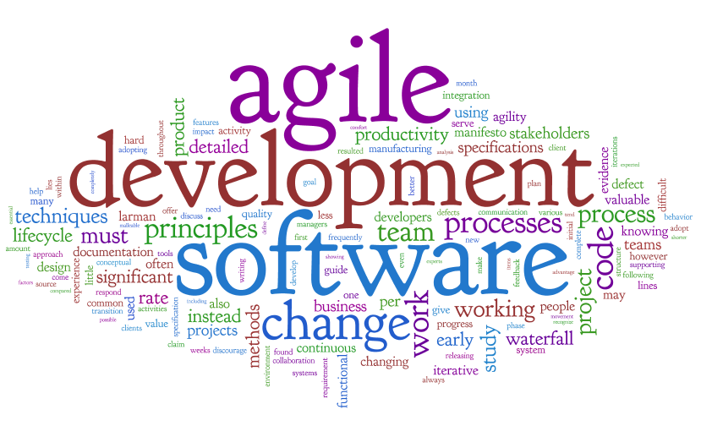
Next time
We will talk about
Agile Development
Various Agile Process Models
How agile teams work

Slide 26

End of Lesson 4
Any questions?

